Slide 1
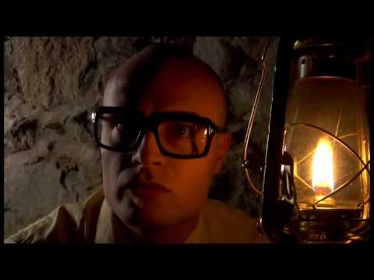
MC Frontalot - It Is Pitch Dark
Notes:
MC Frontalot - It Is Pitch Dark
https://www.youtube.com/watch?v=4nigRT2KmCE

Slide 2
Text Adventure Games
Daphne Ippolito
Chris Callison-Burch
http://interactive-fiction-class.org

Slide 3
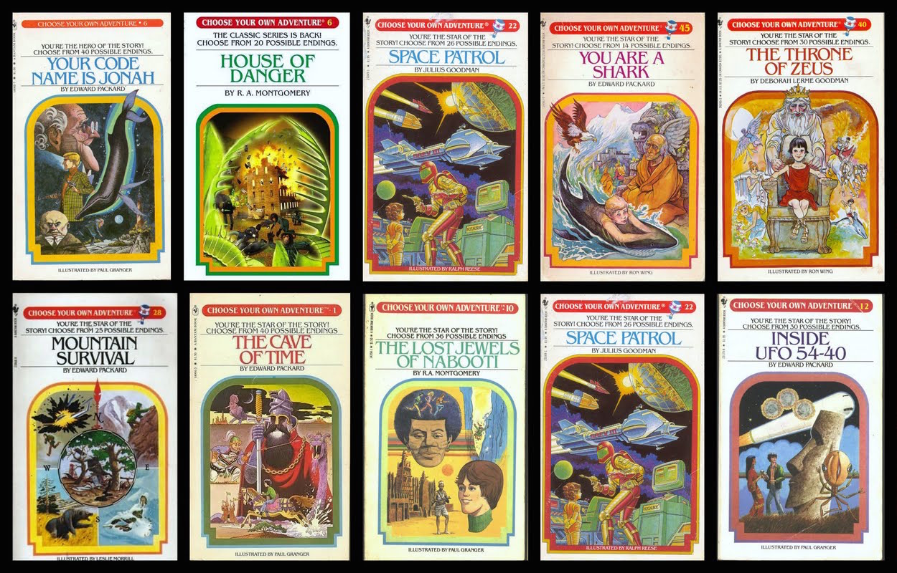
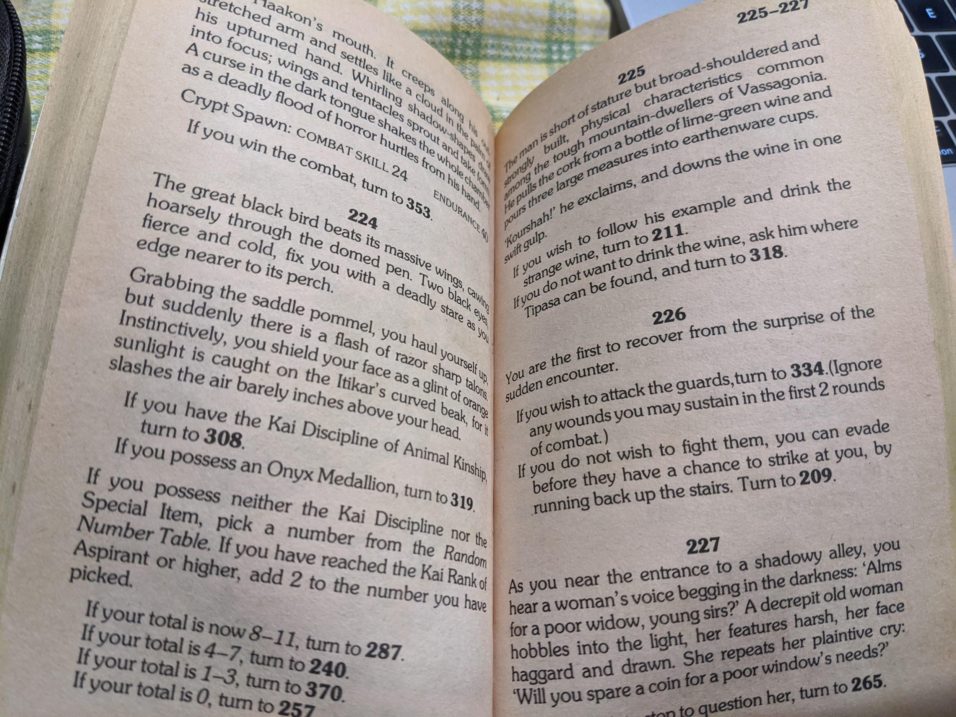
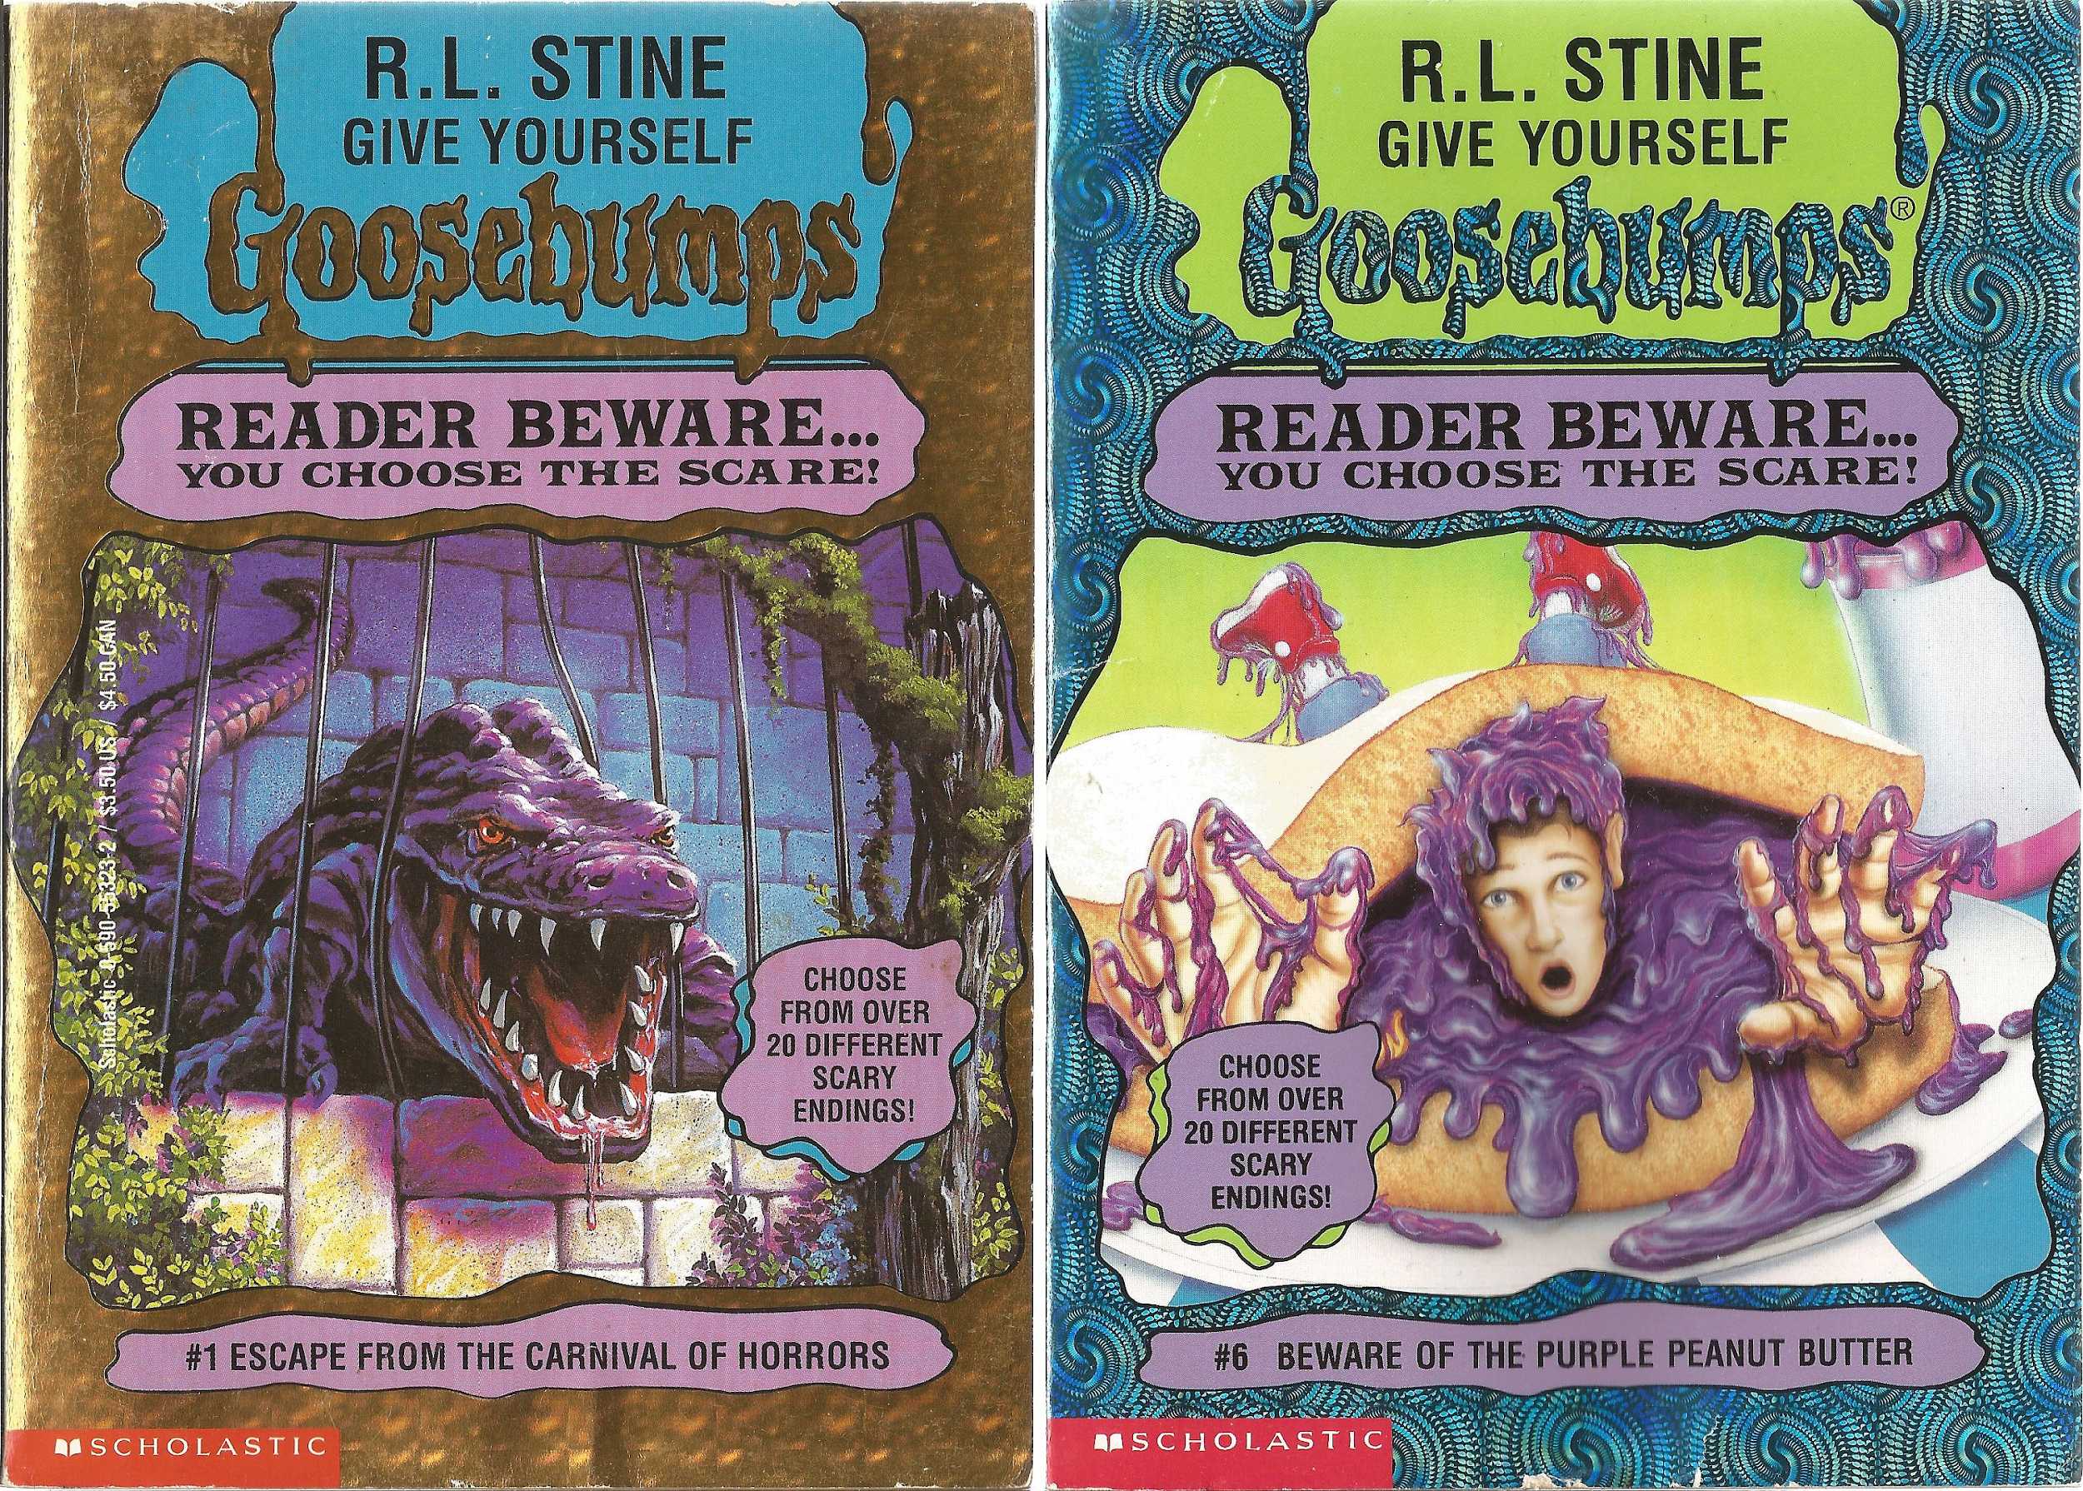
Paper Interactive Fiction
In the 1970s, “Choose your own adventure” books grew in popularity.
Notes:
If you possess the Onyx Medallion, turn to 319.

Slide 4
Notes:
From https://www.seanmichaelragan.com/html/[2008-03-07]_Choose_Your_Own_Adventure_book_as_directed_graph.shtml

Slide 5
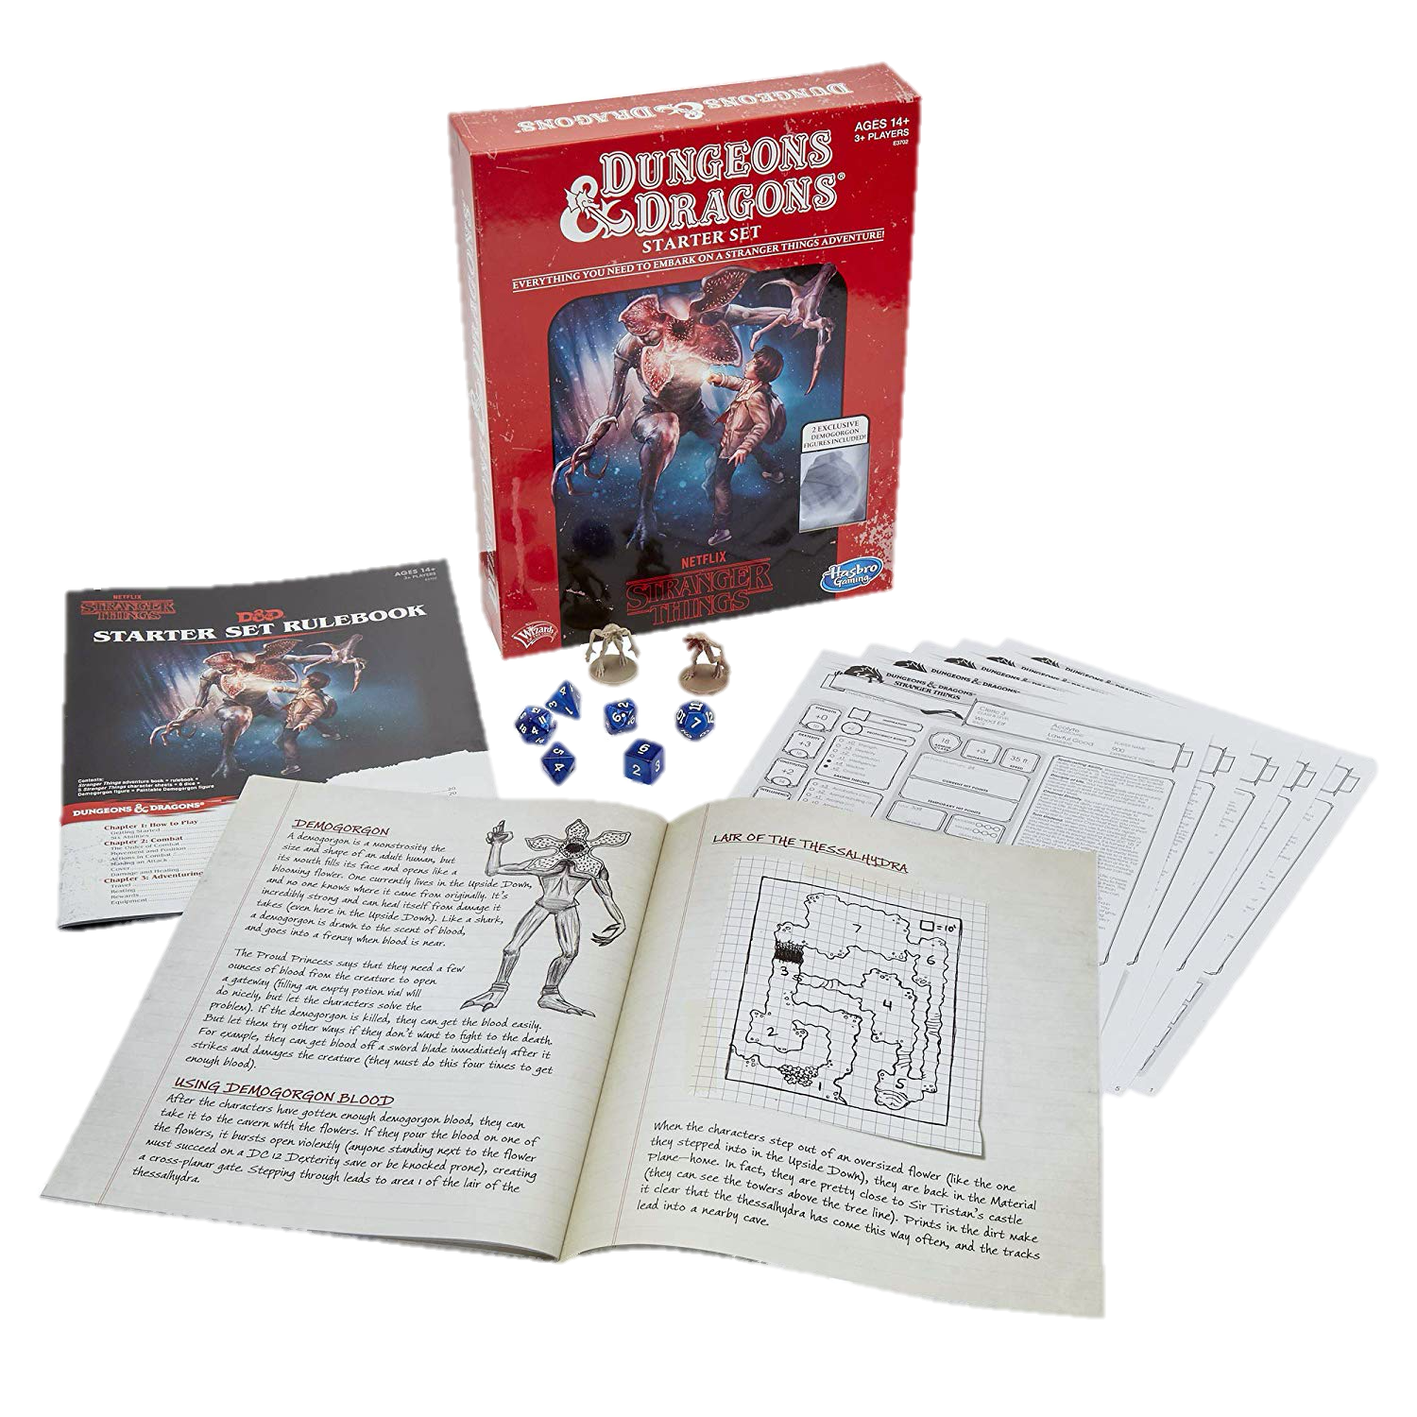
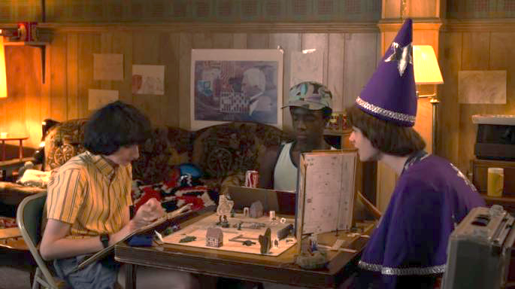
Paper & Pencil Interactive Fiction
Dungeons & Dragons is a fantasy tabletop role playing game first published in 1974.

Slide 6
Computer Games Before Graphics
Interactive Fiction/Text Adventure Games were the best-selling computer games of the 1980s. A company called Infocom created the most popular titles.

Slide 8
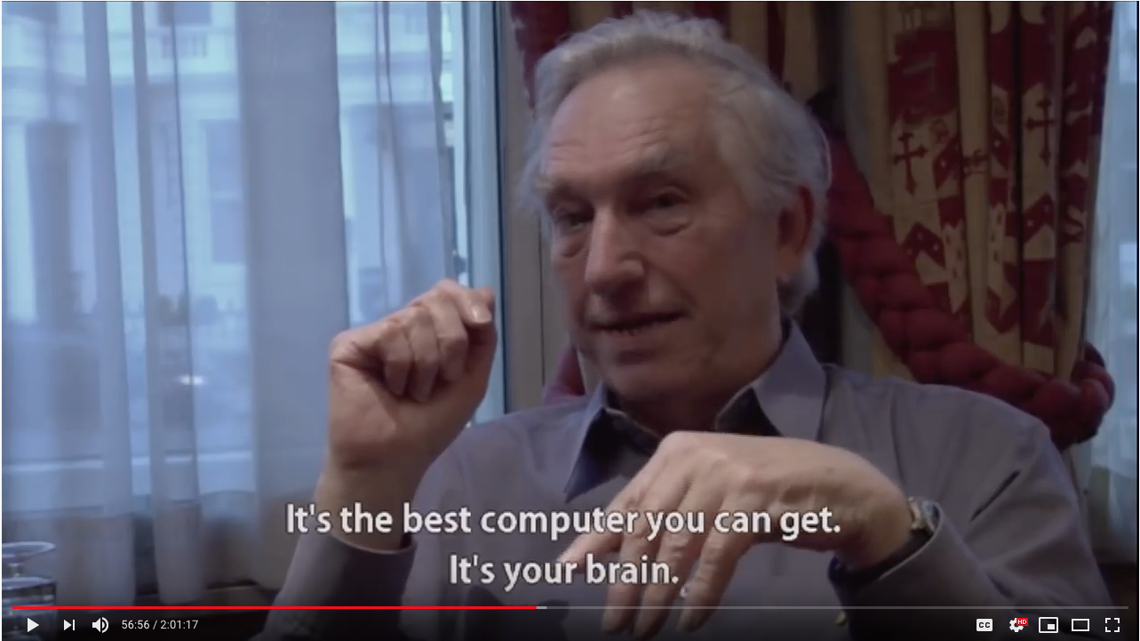
https://www.youtube.com/watch?v=LRhbcDzbGSU&t=3398
Notes:
https://www.youtube.com/watch?v=LRhbcDzbGSU&t=3398
Start at 56:38 - Best computer you can get is your brain / joy of reading + stori
End at 58:21 - Potential end point (“A story can have meaningful consequences … in a way that had never been seen before”)

Slide 9
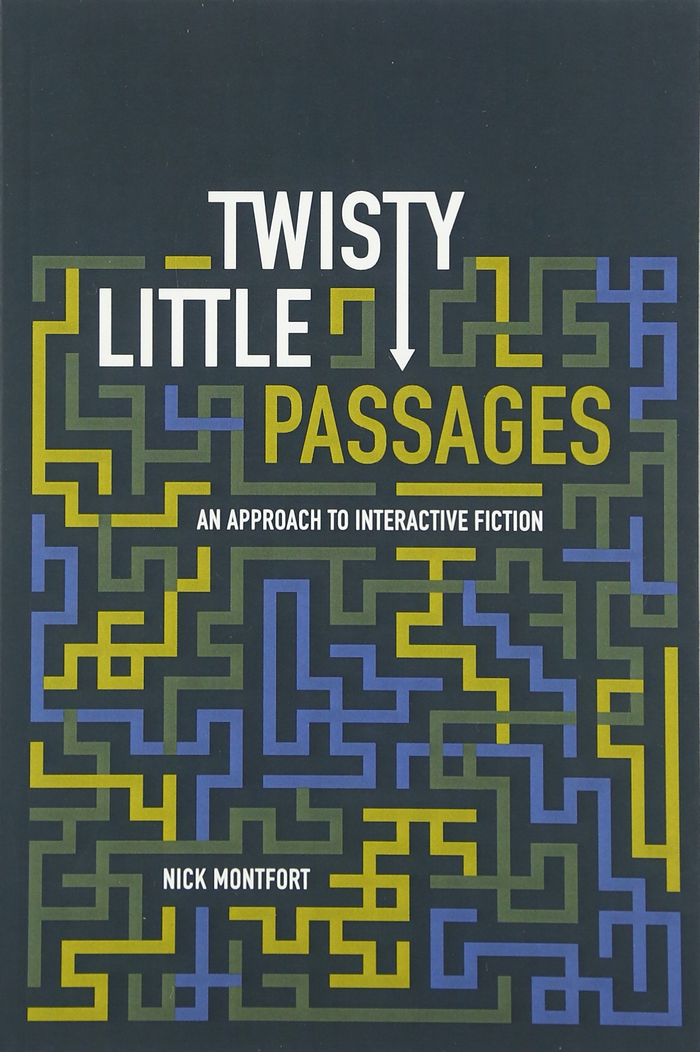
Interactive Fiction Games
The two essential components of interactive fiction are
The parser, which is the component that analyzes natural language input in an interactive fiction work.
The world model, which is setting of an interactive fiction work.
Notes:
The simulated world is represented computationally in some sort of data structure or collection of objects. It is this simulated world that distinguishes a work of interactive fiction from a conversational character or from an expert system that employs natural language understanding.

Slide 10
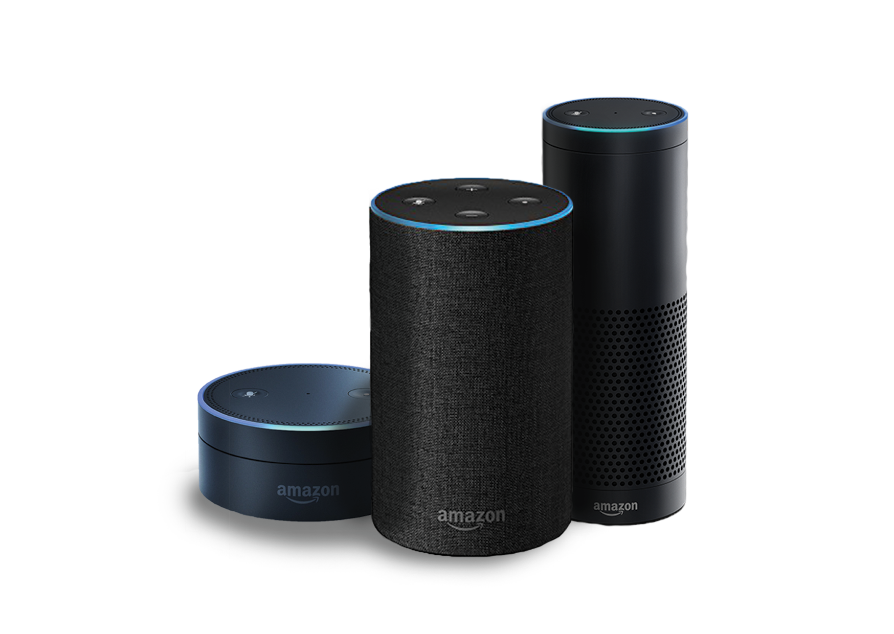

Natural Language Understanding
Will it rain tomorrow? Set an alarm for 6:30a.m. Play music from They Might Be Giants. How many pints are in a gallon? Add blueberries to my shopping list. When did California become a state? When is the Winter solstace? What is the weather like in Hawaii this weekend? Turn off the lights. Open the pod bay doors.

Slide 11
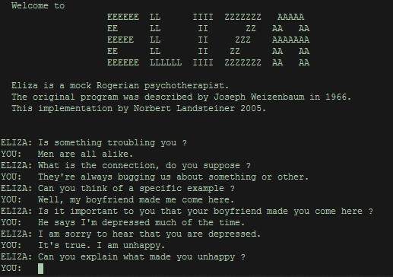
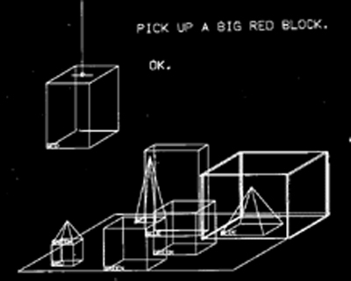
Natural Language Understanding

Slide 12
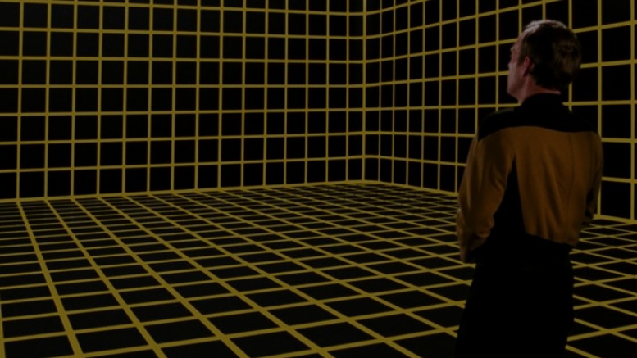
Simulated World
What’s the difference between a conversational agent and a work of interactive fiction? The simulated world.
It represents the physical environment, and things like • Settings or locations • Physical objects in each setting • The player’s character • Non-player characters It also represents and simulates the physical laws of the environment.
Notes:
The world model is typically implemented in the interactive fiction program as some type of graph or tree with associated procedures.

Slide 13
Locations

Slide 14
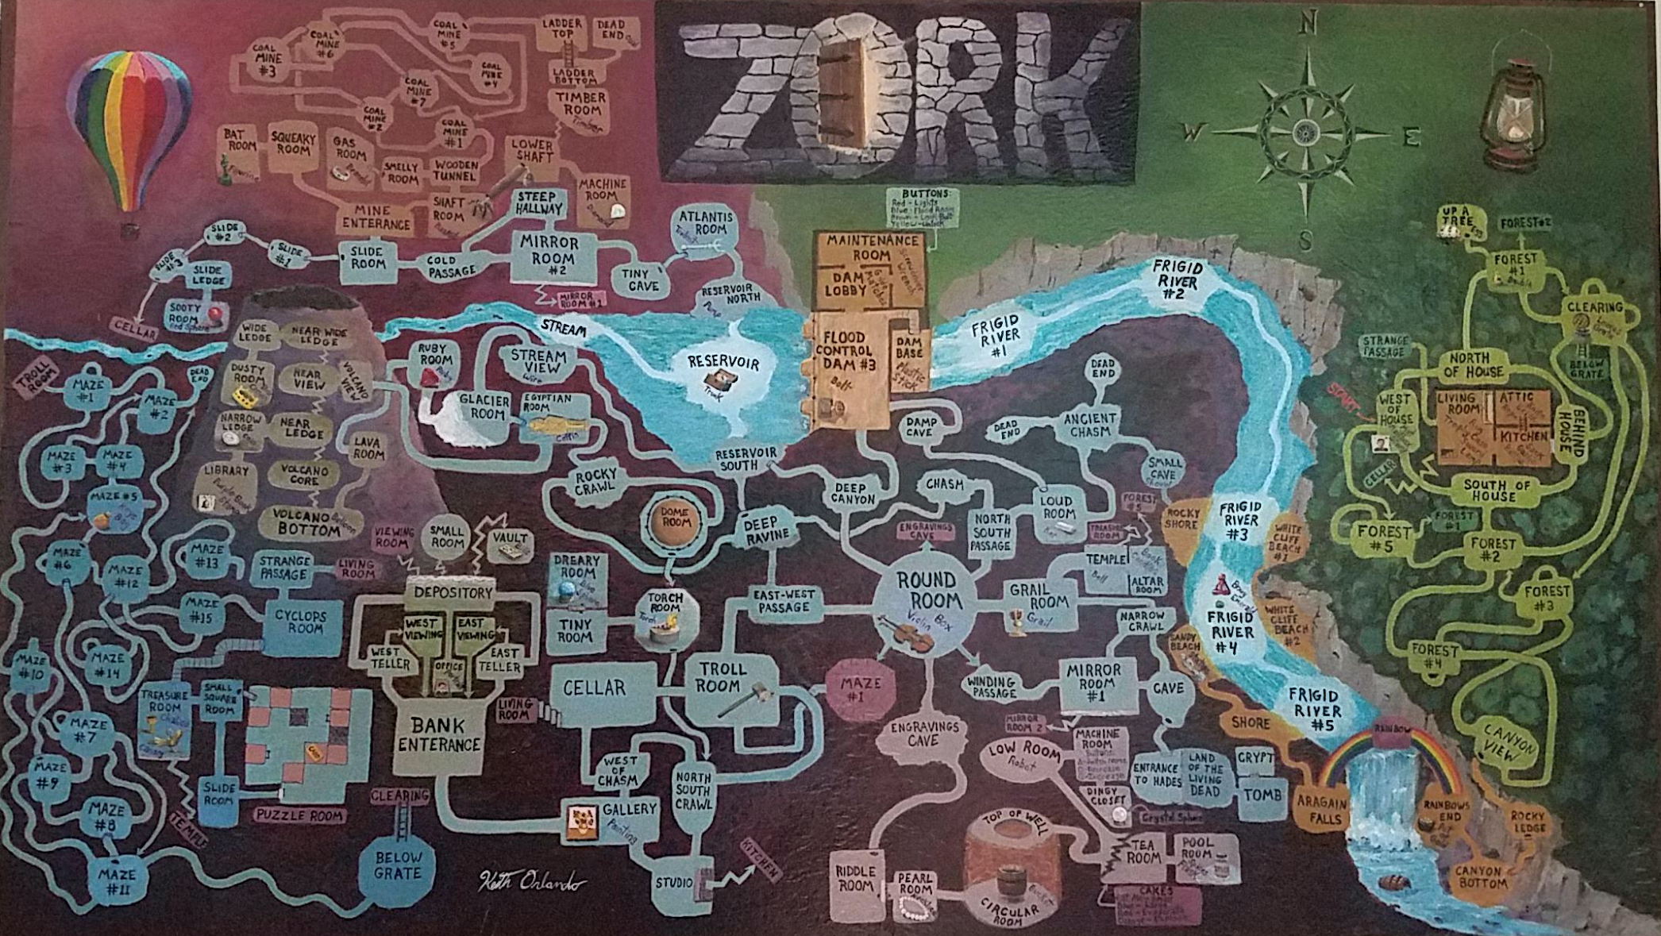
Notes:
Credit: Reddit user ion_bond Source URL: https://www.reddit.com/r/zork/comments/5ximil/zork_map_mit_version_fantastic_game_i_spent_some/

Slide 15
Objects

Slide 16
Verbs

Slide 17
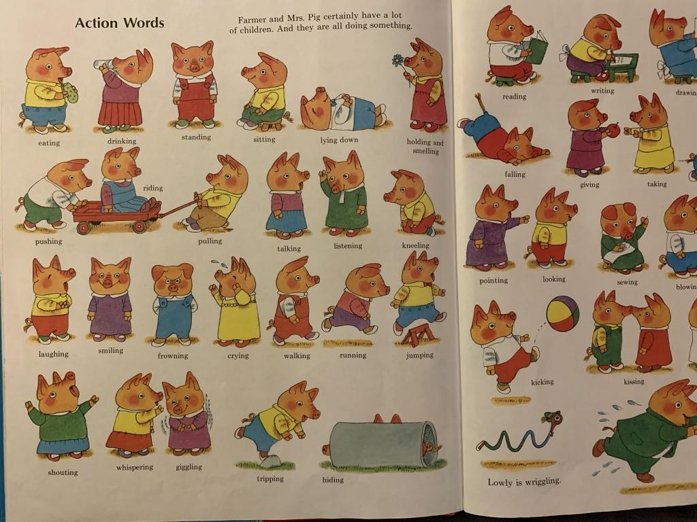
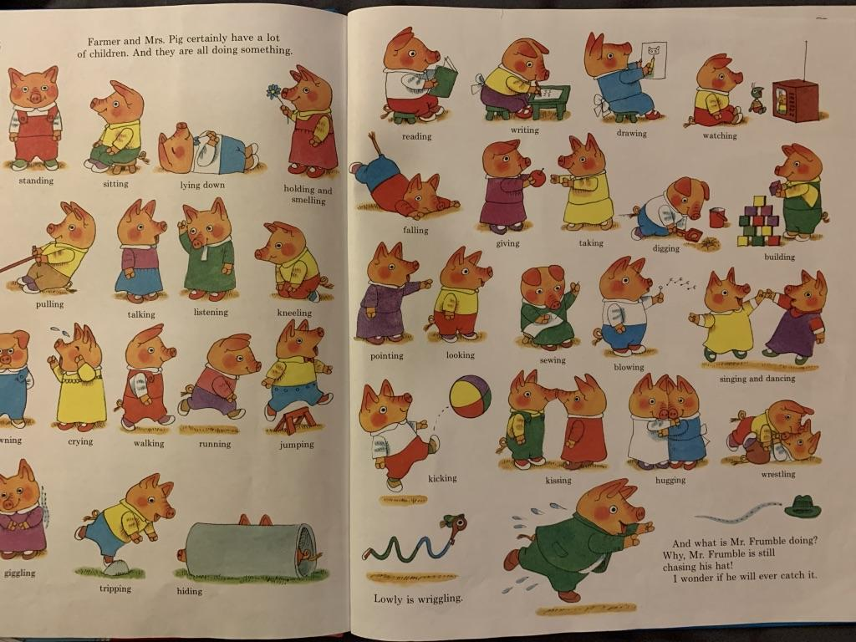
Notes:
Verbs

Slide 18
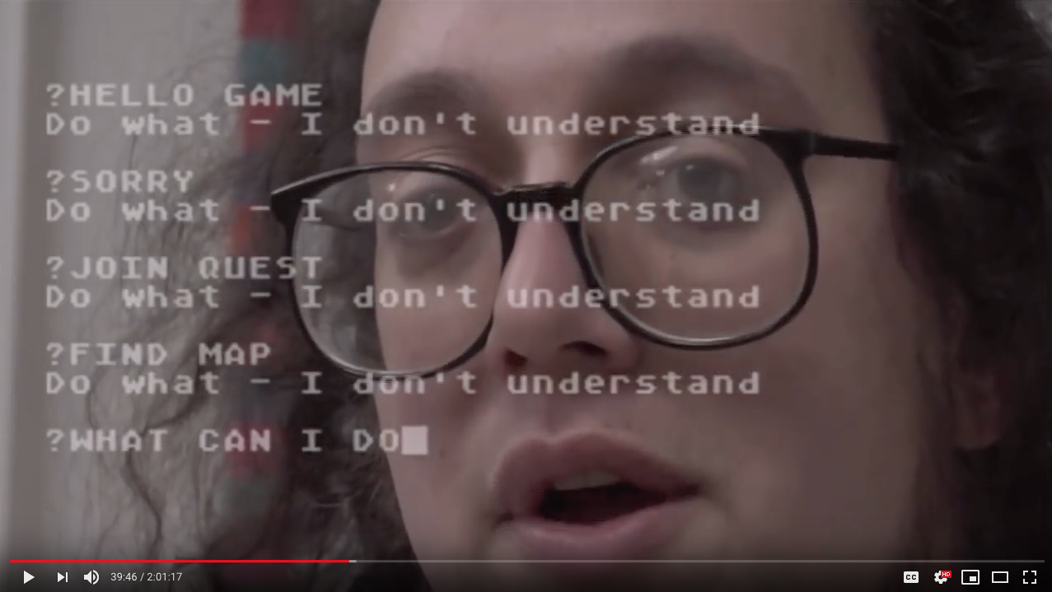
https://www.youtube.com/watch?v=LRhbcDzbGSU&t=2361
Notes:
https://www.youtube.com/watch?v=LRhbcDzbGSU&t=2361
4 minute clip – end at 43:25 (kill the player)
39:20 - Language understanding difficulty
41:30 - ELIZA
43:10 - potential end point (after you’ve implemented it yourself, your perspective changes)
43:25 - potential end point (we just killed the player)

Slide 19
Puzzles

Slide 20
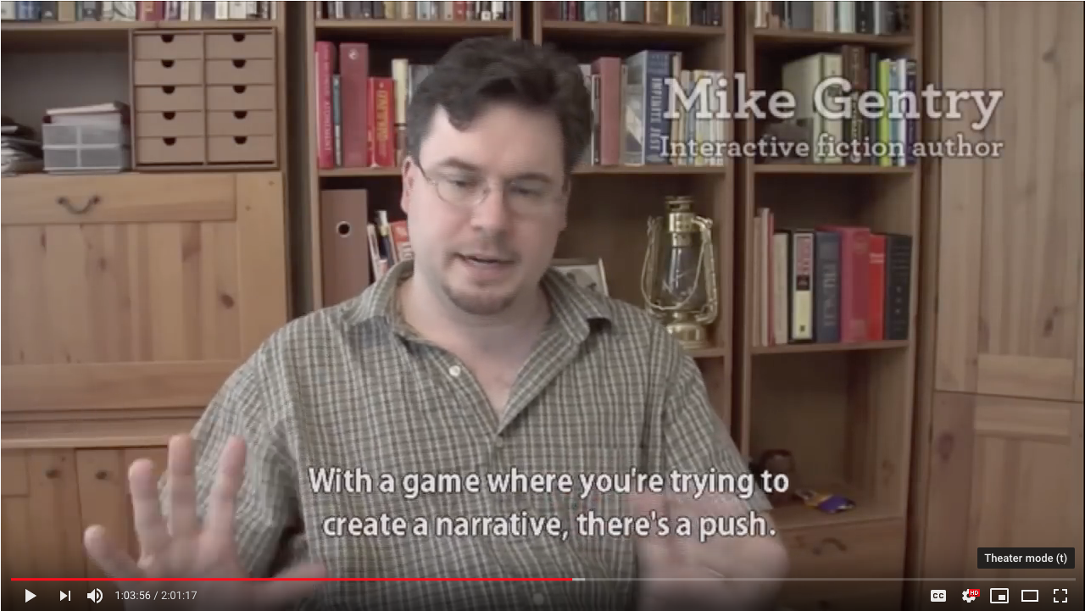
https://www.youtube.com/watch?v=LRhbcDzbGSU&t=3819
Notes:
Puzzles – 2 minutes. https://www.youtube.com/watch?v=LRhbcDzbGSU&t=3819
103:50 - narrative+puzzles
End. 105:56 The actual act of winning is trivial

Slide 21
Stories

Slide 22
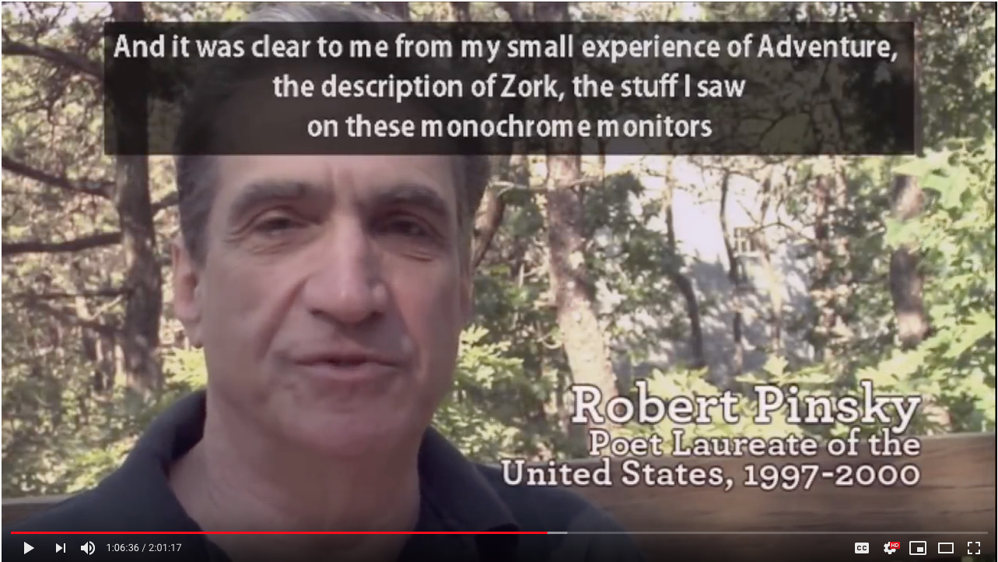
https://www.youtube.com/watch?v=LRhbcDzbGSU&t=3955
Notes:
https://www.youtube.com/watch?v=LRhbcDzbGSU&t=3955
Narratives (The quest – 1 minute)
105:55 - Robert Pinsky
107:06 - potential end - The imagery was very traditional

